Slide 1
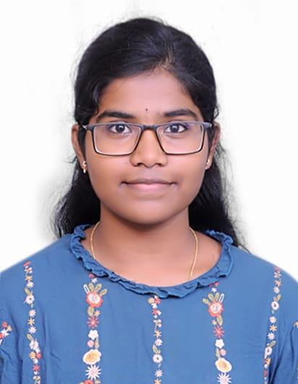
Kumpatla Sai Chaitanya
📍 Amalapuram, AP | 📧 k.chaitanya.work@gmail.com | 📞 +91 8179586759
🔗 GitHub: github.com/chaitanyakumpatla | LinkedIn: linkedin.com/in/chaitanya-kumpatla
Academic Background
M.Tech in Computer Science – AI & ML, VIT Vellore, TN (pursuing) | CGPA: 8.5/10
B.Tech in CS - Bonam Venkata Chalamayya Engineering College, AP | CGPA: 8.56/10
Internship
Research Intern – BNPRS Pvt. Ltd. (Aug 2024 – Jan 2025)
Worked on Contactless Fingerprint Recognition using OpenCV & Python.
Focused on image preprocessing & feature extraction.
Enhanced accuracy and efficiency of biometric systems.
Key Projects
Code Review using GitHub Copilot: Implemented an end-to-end, GitHub Copilot-driven workflow for standardized application development and code review, ensuring adherence to industry coding standards.
LogSentinel: Log anomaly detection using LLaMA & BERT with PEFT for edge deployment.
E-commerce AI Chat Agent: Natural language interface for sales data analysis using LangChain & Gemini LLM.
Secure OCR App: Streamlit-based OCR pipeline with Kafka & PostgreSQL for secure ML-ready text storage
Skills
Technical Skills: Machine Learning, Deep Learning, Computer Vision, Prompt Engineering.
Computer Languages: C, C++, Python, SQL.
Libraries and Frameworks: NumPy, Pandas, Scikit-learn (ML); TensorFlow, PyTorch (DL); OpenCV (CV).
Tools and Platforms: Power BI, Power Automate, Hugging Face, Docker, MySQL, Git, VS Code.
Soft Skills: Effective Communication, Problem-Solving, Team Collaboration

